Slide 1
Health Care Delivery System in India
Dr.Ch.Prashanthi
3rd year pg student
Dept of Public Health Dentistry

Slide 2
Introduction
Health
Health care
Health care provider
Health services
System
…

Slide 3
Components of healthcare delivery system
Structure
Process
Outcomes
Flow of patients

Slide 4
Levels of health care
Secondary health care
Primary health care
Primary Health care
Provided at the community level
Secondary health care
Provided at CHC, DH etc.
Tertiary health care
Provided at hospitals
Tertiary health care

Slide 5
ALMA ATA DECLARATION-HEALTH FOR ALL BY 2000 AD
PRIMARY HEALTH CARE

Slide 6
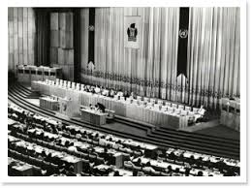
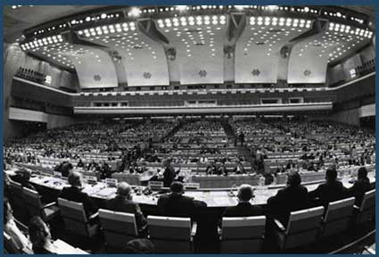
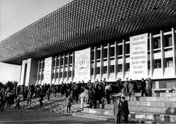
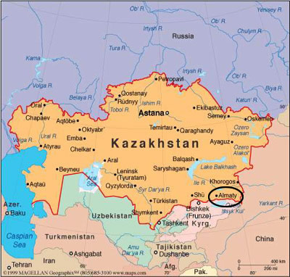
Alma-Ata conference, 1978

Slide 7
Primary health care
Essential health care; based on
practical,
scientifically sound, and
socially acceptable method and technology….
made universally accessible to individuals and families of the community through their full participation and at a cost that community and country can afford to maintain every stage of their development in the spirit of self determination.

Slide 8
Elements of primary health care
Education about prevailing health conditions and methods to prevent and control them
Promotion of food supply and proper nutrition
Adequate water supply and basic sanitation
Maternal and child health care with family planning
Immunization against major infectious diseases
Prevention and control of locally endemic diseases
Appropriate treatment of common diseases and injuries
Provision of essential drugs

Slide 9
Principles of primary health care
Equitable distribution
Community participation
Intersectoral coordination
Appropriate technology

Slide 10
HEALTH CARE SYSTEM -MODEL
Health status or health problems
Curative
Preventive
Promotive
Public
Private
Voluntary
Indigenous
Changes in health status
Resources

Slide 11
Health System in India
The health system in India has 3 main links
Central
Local or peripheral
State

Slide 12
At the central level
The official “organs” of health system at national level are
The Ministry of Health and Family welfare
The directorate general of Health Services
The central council of health and family welfare

Slide 13
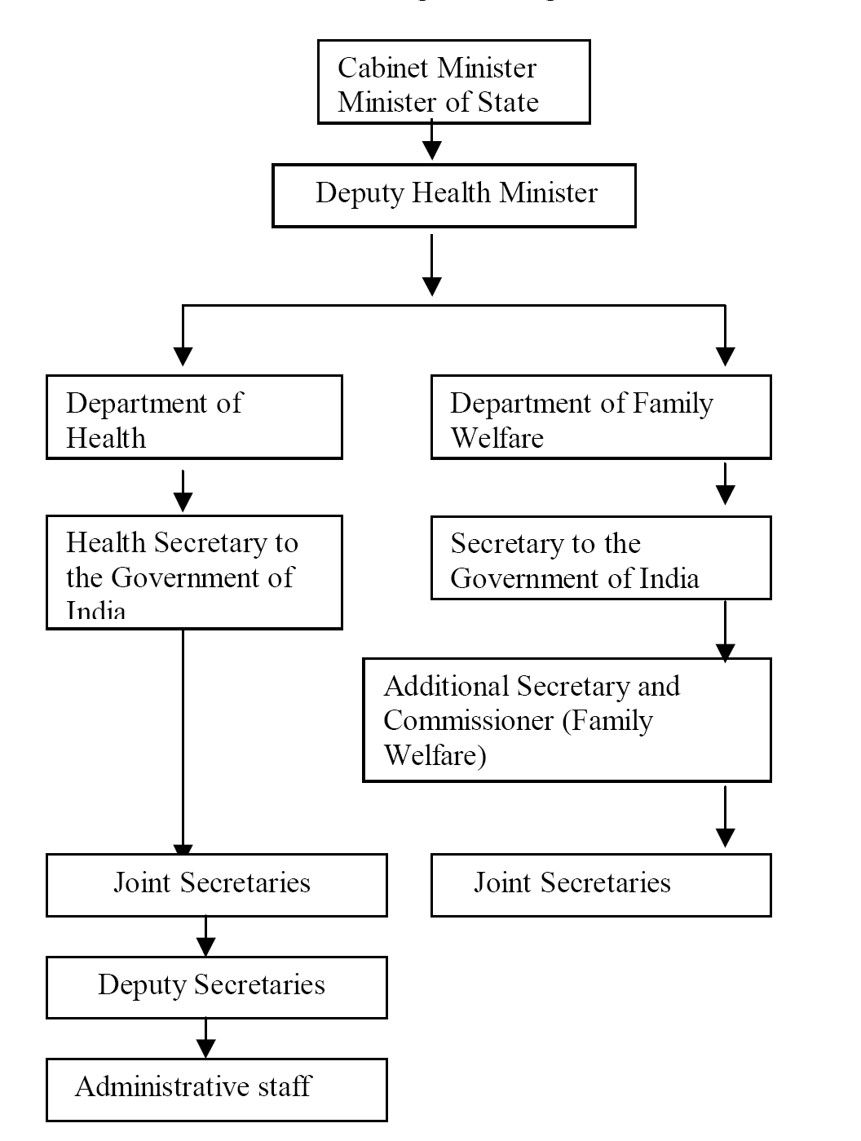
Ministry of Health and Family Welfare

Slide 14
Functions of MoHFW
Union list
Concurrent List:

Slide 15
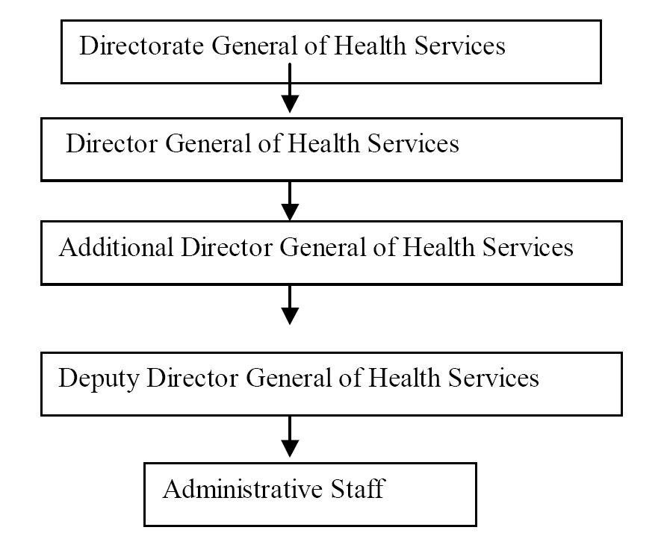
Directorate General of Health Services

Slide 16
Functions of Directorate General of Health services
General functions
Specific function

Slide 17
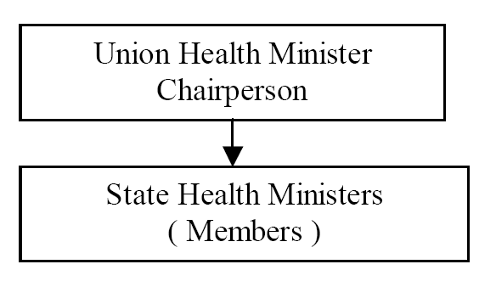
Central Council of health

Slide 18
Functions
To consider and recommend broad outlines of policy related to matters concerning health like environment hygiene, nutrition and health education.
To make proposals for legislation relating to medical and public health matters.
To make recommendations to the Central Government regarding distribution of grants-in-aid.

Slide 19
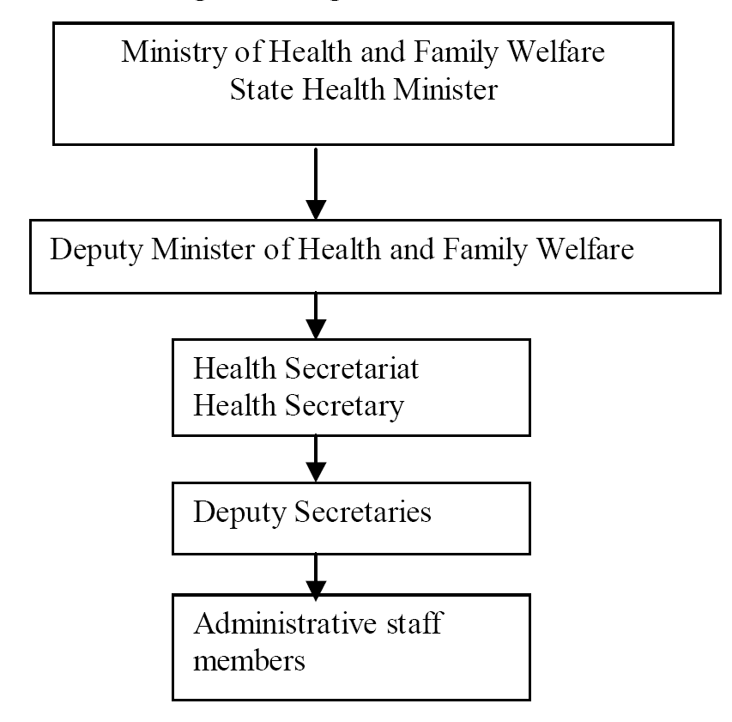
State Level

Slide 20
Functions at state ministry
Provide adequate medical care through hospitals , dispensaries, health centres both in Urban and rural areas.
Proper arrangements for Medical education &research
Proper Implementation of the National Health Programme.
Make provisions for personal and impersonal health services like nutrition , school health, Industrial health , Family planning
Control of food and drug administration.
Collection and Dissemination of health information.
Promotion of indigenous system of medicine.
Setting up of laboratories, provision of family welfare services.
Enforcement of the professional standards.
Control and supervision of local bodies.

Slide 21
At District level
There are 593 ( year 2011 census) districts in India. Within each district, there are 6 types of administrative areas.
1. Sub –division
2. Tehsils ( Talukas )
3. Community Development Blocks
4. Municipalities and Corporations
5. Villages and
6. Panchayats

Slide 22
District Level
Districts
Tehsils /Talukas (200-600 villages)
Town Area Committee (5,000-10,000 Pop)
Community Development Blocks (approx 100 Villages & 80,000 -1.2 Lac Pop)
Municipal Board (10,000- 2 Lac Pop)
Municipalities & Corporations
Villages
Corporations (> 2 lac pop)
Panchayats

Slide 23
Health Services
Out patient services
Clinics
Institutions
In broad sense the health services should be
Comprehensive
Accessible
Acceptable
Provide scope of community participation and….
Available at an affordable cost by country and commuity

Slide 24
Health care systems
Public health sector
Primary health care
Primary health centres
Sub centres
Hospitals/Health centres
Community health centres
Rural hospitals
District hospitals/health centres
Specialist hospitals
Teaching hospitals
Health insurance schemes
Employees State Insurance
Central Govt. Health Schemes
Other agencies
Defense services
Railways

Slide 25
Private sector
Private hospitals, polyclinic, nursing homes and dispensaries
General practitioners and clinics
Indigenous system of medicine
Ayurveda and Siddha
Unani and Tibbi
Homeopathy
Unregistered practitioners
Voluntary health agencies
National health programmes

Slide 26
Primary health care in India

Slide 27
Rural Health care system in India
Community Health Centre (CHC)
A 30 bedded Hospital/ Referral unit for 4 no. of PHCs with specialized Health Services
Primary Health Centre (PHC)
A Referral unit for 4-6 Subcentres; 4-6 bedded manned with a Medical Officer in-charge and 14 subordinate paramedical staff no. of PHCs with specialized Health Services
Sub Centre (SC)
Most peripheral contact point of community with Primary Health Care system; manned with one MPW(M) and MPW(F)

Slide 28
Rural Health care system in India
The health care infrastructure in rural areas has been developed as a three tier system and is based on the above population norms.
Health Facility | Population Norms
 | Plain Area | Hilly/Tribal/Difficult Area
Sub-Centre | 5000 | 3000
Primary Health Centre | 30,000 | 20,000
Community Health Centre | 1,20,000 | 80,000

Slide 29
Sub Center
They are established on the basis of
One SC for every 5,000 pop in general and…
One SC for every 3,000 pop in hilly, tribal and backward areas
Each Sub-Centre is manned by one Male and one female Health Worker.
One Lady Health Worker (LHV) is entrusted with the task of supervision of six Sub-Centers.

Slide 30
Sub Centre are assigned tasks relating to interpersonal communication
…..in order to bring about behavioral change and provide services in relation to….
Maternal and child health,
Family welfare,
Nutrition,
Immunization,
Diarrhea control and
Control of communicable diseases programmes.
The sub centre are provided with basic drugs for minor ailments.

Slide 31
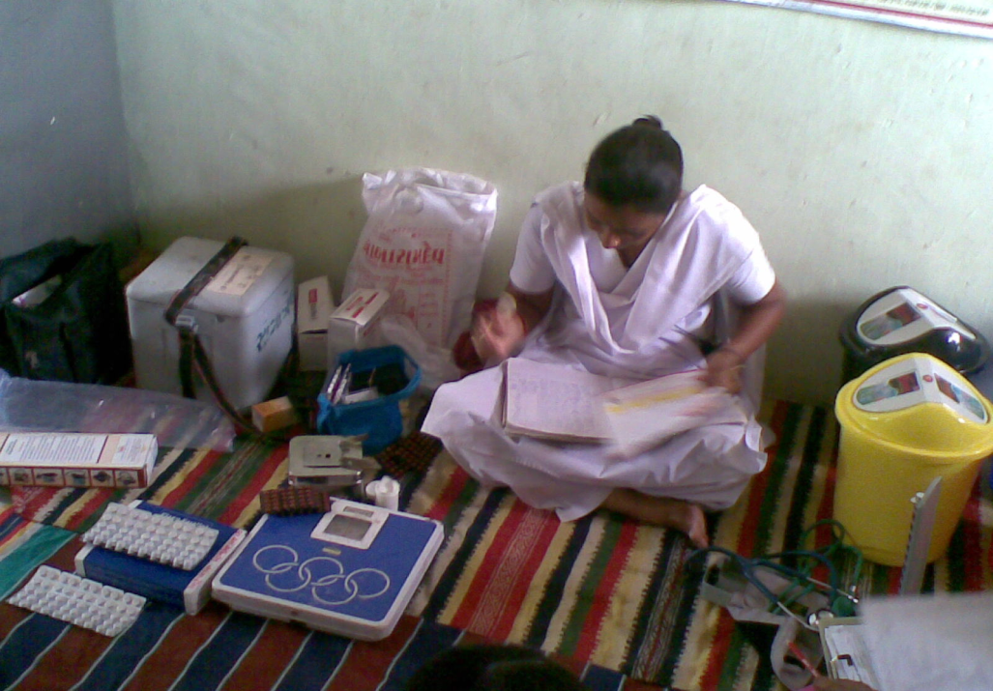
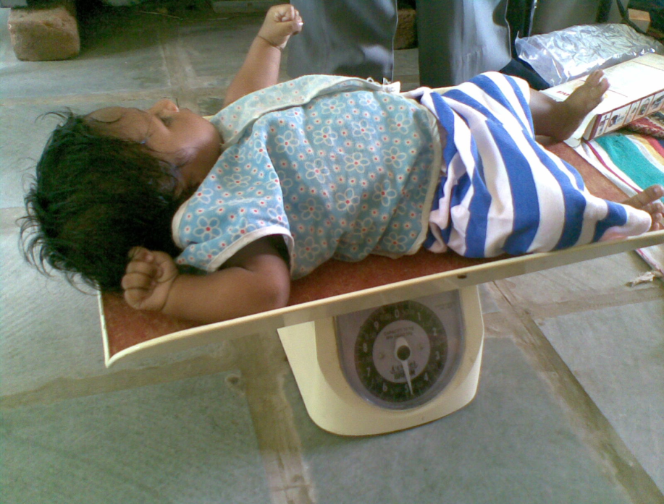
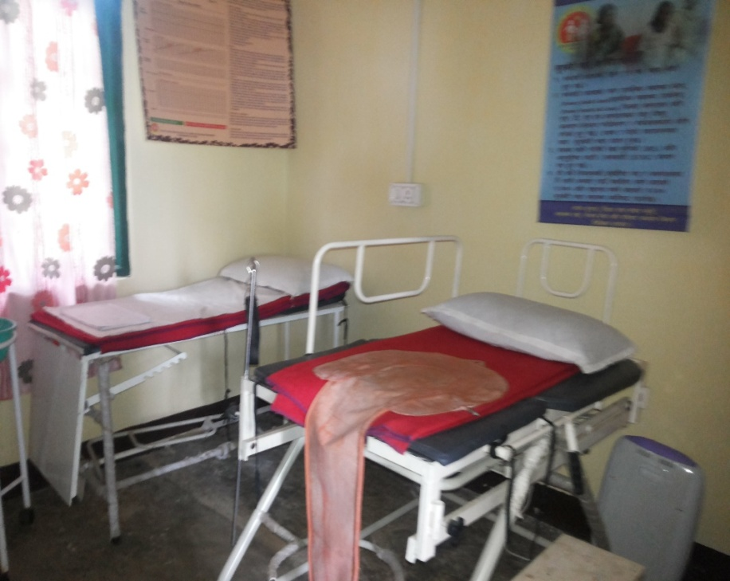
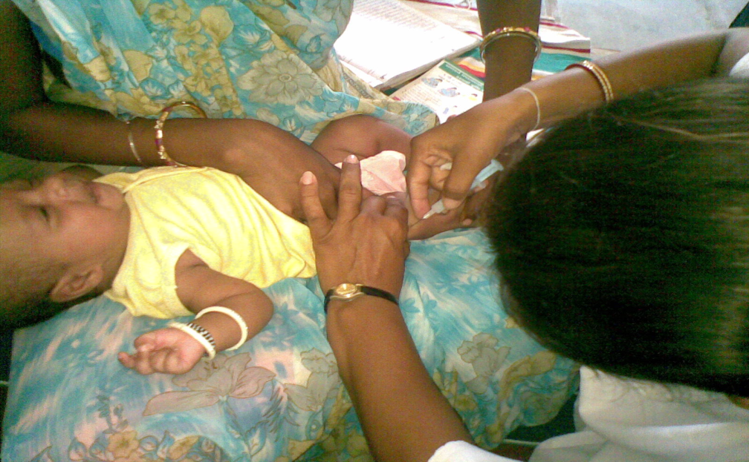
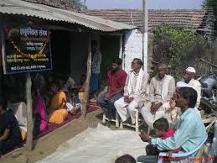

Slide 32
Primary Health Center
PHC is the first contact point between village community and the Medical Officer.
integrated curative and preventive health care to
At present, a PHC is manned by a Medical Officer supported by 14 paramedical and other staff.

Slide 33
It acts as a referral unit for 6 SubCentres.
It has 4 - 6 beds for patients.
The activities of PHC involve curative, preventive, primitive and Family Welfare Services.
National Health Plan (1983) proposed reorganization of PHCs on the basis of….
One PHC for every…..30,000 pop in Rural areas
One PHC for every…..50,000 pop in Urban areas

Slide 34
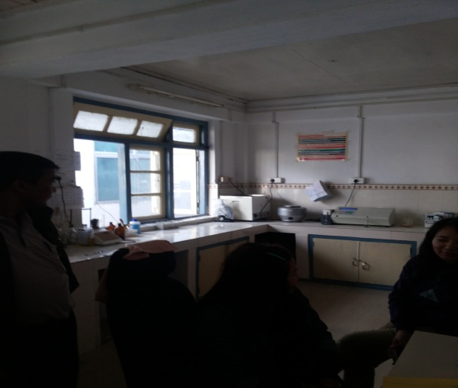
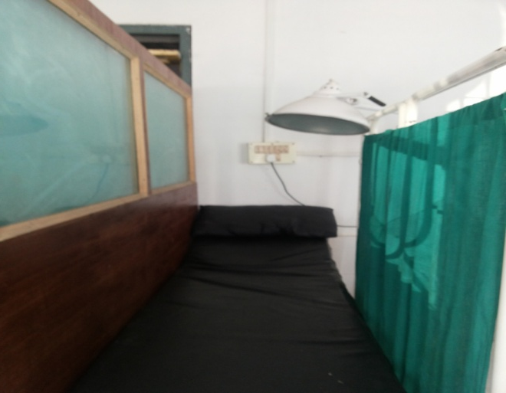
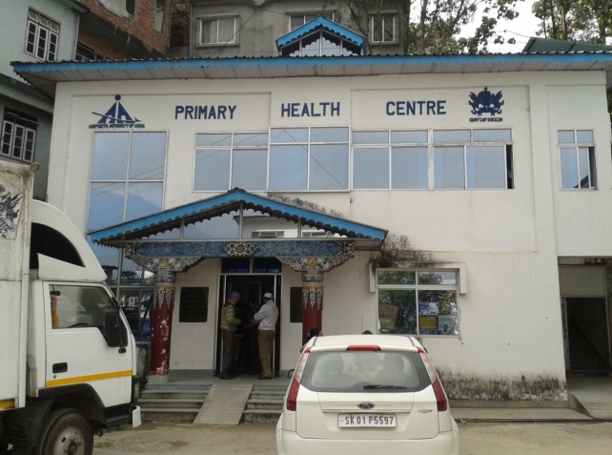
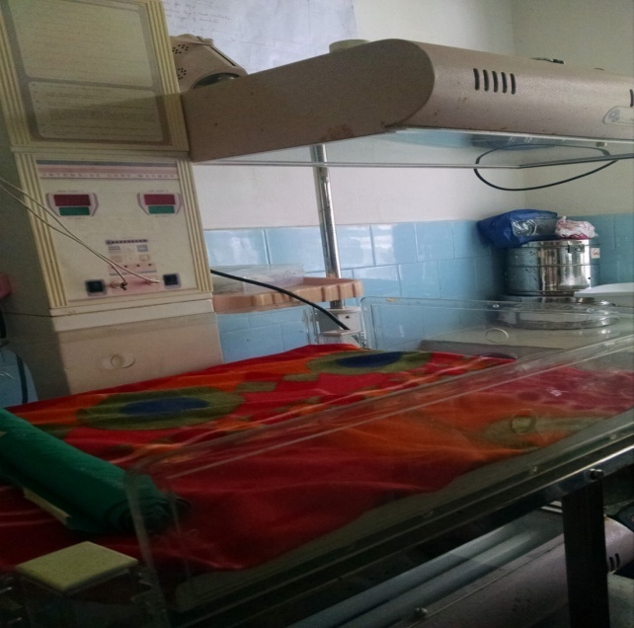
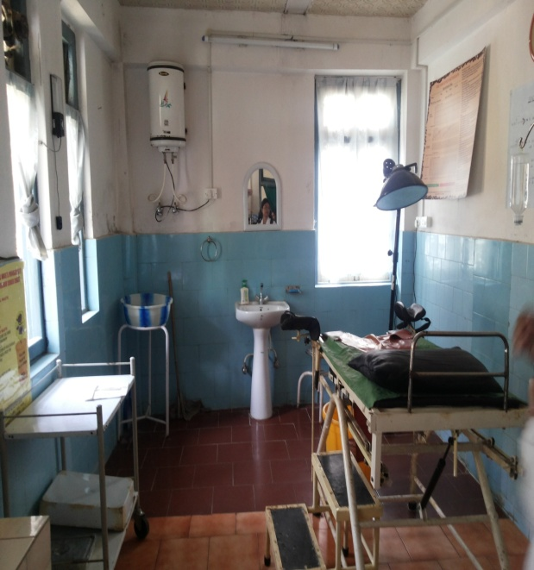
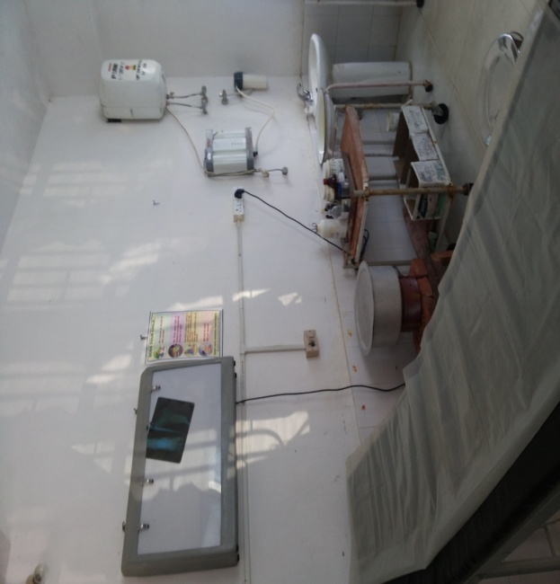
PHC

Slide 35
Functions of PHCs
Medical care
Health programmes
MCH care and family planning
Health education and training
Referral services
Safe water supply and basic sanitation
Prevention and control of locally endemic diseases
Collection and reporting of vital events
Basic laboratory services

Slide 36
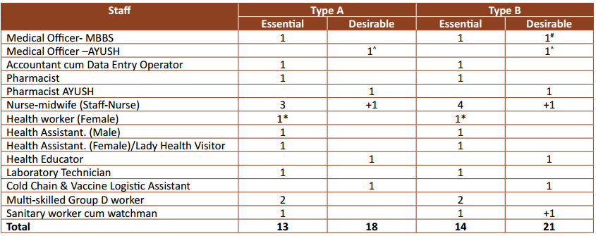
Staffing of PHCs

Slide 37
Community Health Center (CHC)
8000 to 1.2 lakh
It has 30 in-door beds with one OT, X-ray, Labour Room and Laboratory facilities.
It serves as a referral centre for 4 PHCs and also provides facilities for obstetric care and specialist consultations.

Slide 38
Functions of CHCs
Care of Routine and Emergency Cases in Surgery
Care of Routine and Emergency Cases in Medicine
Maternal health care
Newborn Care and Child Health
Family planning
School health services

Slide 39
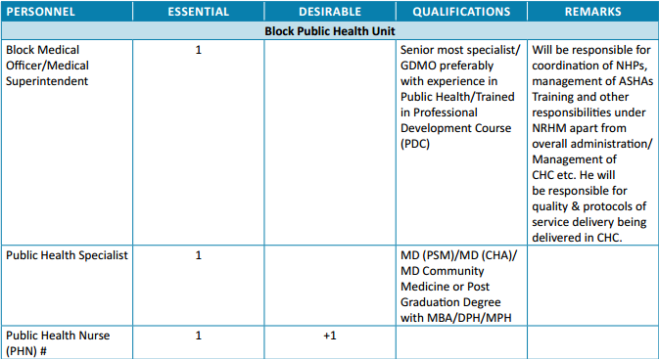
Staffing of CHCs

Slide 40
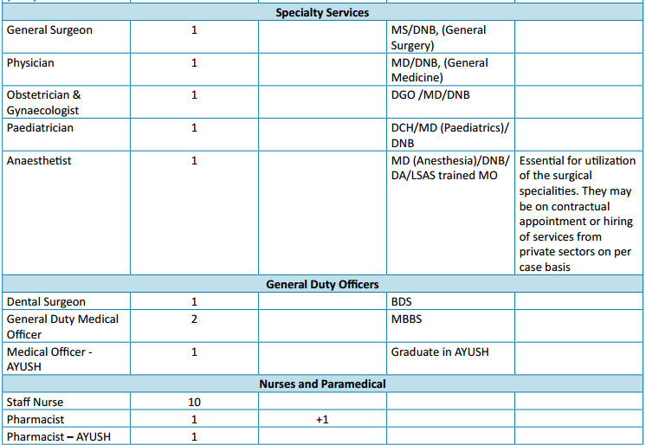

Slide 41
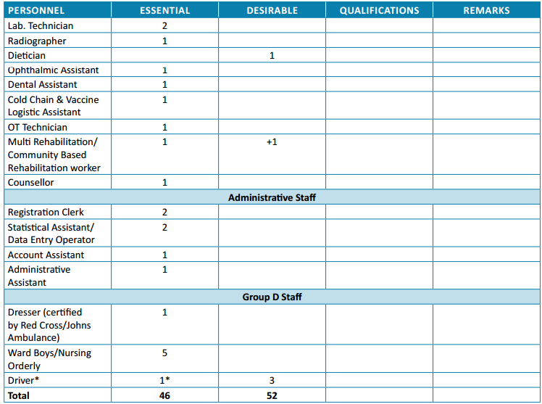

Slide 42
SHORTCOMINGS OF HEALTH CARE DELIVERY SYSTEM IN INDIA
1.Inverse care.
2.Impowerising care.
3.Fragmented and fragmenting care.
4.Unsafe care.
5.Misdirected care.

Slide 43
RECOMMENDATIONS
Integration between all sectors
Emphasis on health promotion and disease prevention
Monitoring of health status and needs
Evidence based,cost-effective,equitable,universal,ethical and comprehensive care
Improve conditions
Overcome barriers

Slide 44
To be continued…
-ORAL HEALTH CARE DELIVERY SYSTEM
Thank you

